Slide 1
Expectations for Proof of Concept: OCR & Agentic AI
HKRI x Amazon Web Services (AWS)
3-Jun-2025 (Tue)

Slide 2
Agenda
Introduction
Overview of Invoice Samples
OCR Expectations
Agentic AI Expectations
Expected Outcome & Timeline for POC
POC Success Criteria
Future Exploration

Slide 3
Introduction
Purpose of Presentation: To outline expectations for the Proof of Concept relating to invoice processing and vendor identification using AI technologies.

Slide 4
Overview of Invoice Samples
Content:
Invoice generation methods:
Original PDF from Microsoft Word
Printed and photocopied PDF
Expectation: We would like to evaluate the accuracy of reading these invoices generated through different formats.
Visual: Sample invoice in 2 different generation methods to be displayed in the next slide.

Slide 5
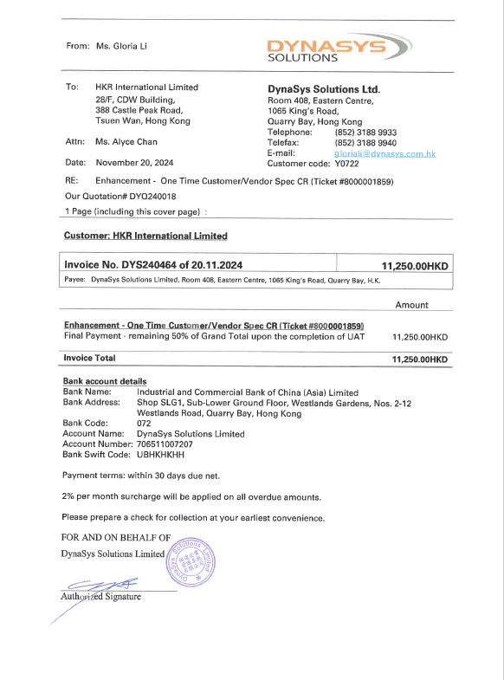
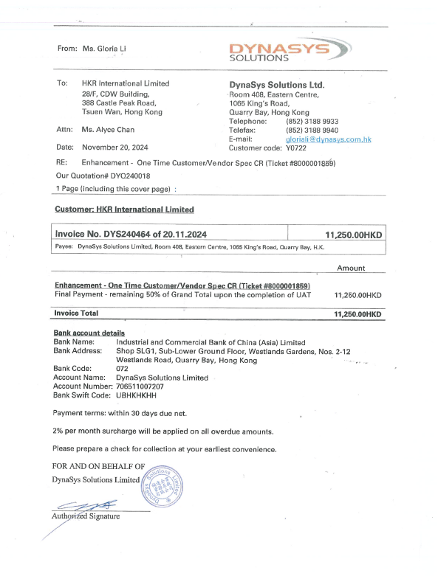
Original PDF from Microsoft Word
Printed and photocopied PDF

Slide 6
OCR Expectations
Key Requirements:
Precise identification of the following fields from invoices:
Vendor
Invoice Date
Payment Terms
Due Date
Currency
Invoice Total Amount
Invoice Line Items (Description and Amount)
Special Remarks from Vendor if any
Vendor's Bank Account, Bank Code, and SWIFT code
Meter Number, Delta of Readings on Water Bills
Expectation: Accurate recognition and result in column format with Column Title and can be used for further AI processing. For Water Bills, it is expected to identify Meter Code.
Visual: Sample Invoice of the Water Bills and Invoice with “0” Amount/ “Included” Line Items.

Slide 7
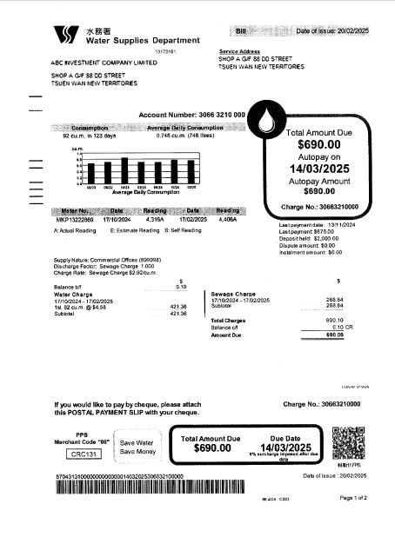
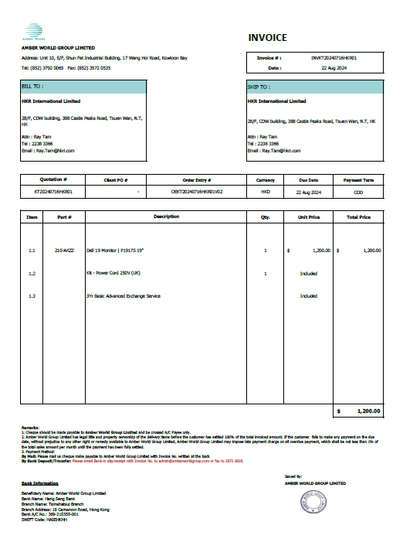
Water Bill
Invoices with “0” Amount/ “Included” Line Items

Slide 8
Agentic AI Expectations
Key Use Case 1:
Use the prepared Vendor list to find the appropriate Vendor Code based on the names identified from invoices.
Challenges:
Vendor Code and Vendor Name split into two columns
One missing Vendor in the list
Vendor Name with similar wordings
Water Bill’s Vendor is HKSAR Government but not Water Suppliers Department.
Vendor Code Column contains Various Data Format.
Column Title is not straight forward for machine reading
Small sample population.
Expectation: Accurate matching of Vendor Code and give alert if the Vendor Code derived is not from 100% matched Vendor Name. The potential ambiguity due to mixed vendor names in the supplier list. Want to understand how the missing Vendor information impacting the remaining process.
Visual: Vendor List to be displayed in the next slide.

Slide 9
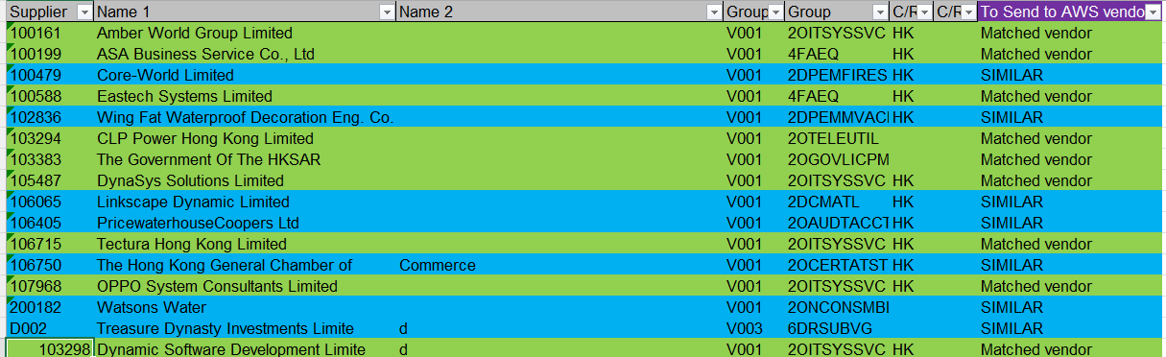
Shortlisted Vendor List

Slide 10
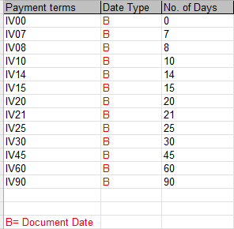
Agentic AI Expectations
Key Use Case 2:
Use the prepared Payment Term list to find the Payment Code based on the Payment Terms identified from invoices.
Additional Note on the Challenges:
Terms used on vendor invoices may have variety.
Only number value in Payment Term List can be used to do matching.
Expectation: Accurate matching of Payment Term Code. Give alert when Payment Term Code is not matched.
Visual: Payment Term List.

Slide 11
Agentic AI Expectations
Key Use Case 3:
Identify Refund on the over-payment or deposit for Utility Bills.
Additional Note on the Challenges:
Financial Operation of Refund is only initiated when there is payment received from bank cheque/cashier order.
Use mapping table to derive our bank account.
Refund Amount to be expressed in negative sign.
Expectation: Accurate differentiation of regular bills and refund.
Visual: Sample Refund Payment and Bills to be displayed in the next slides.

Slide 12
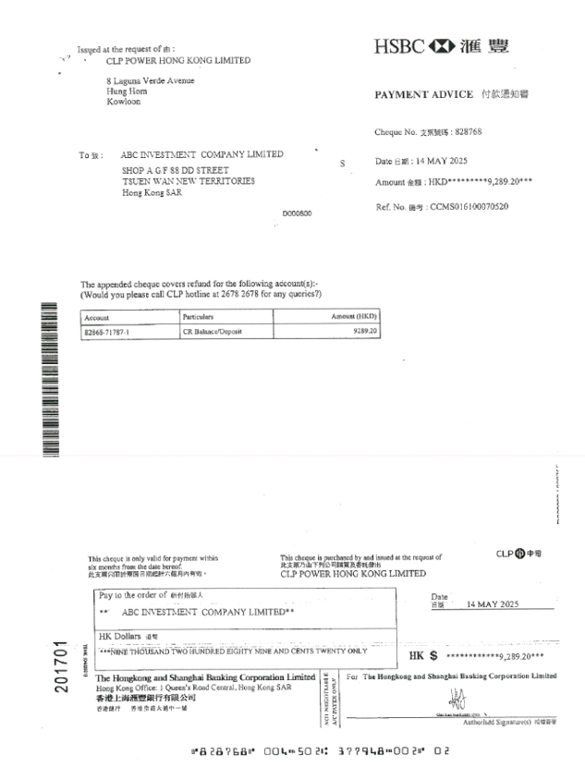
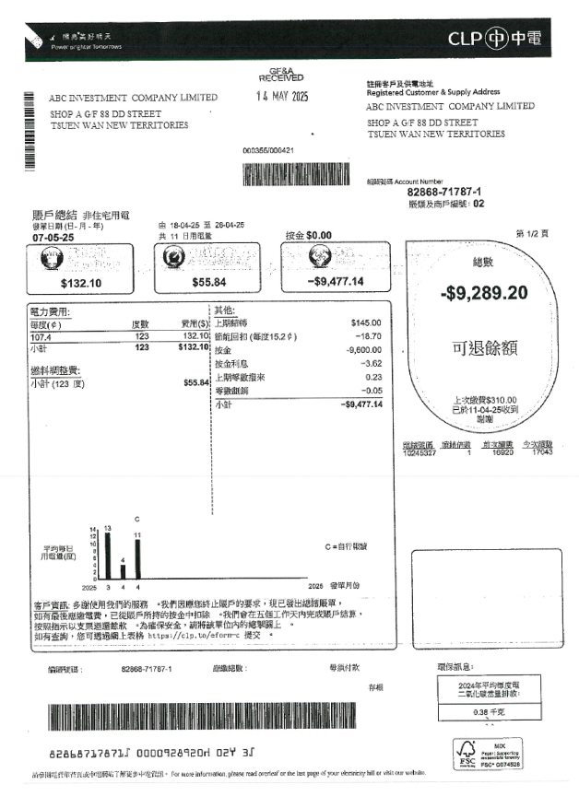
Payment Advice from Bank
Refund Credit Note

Slide 13
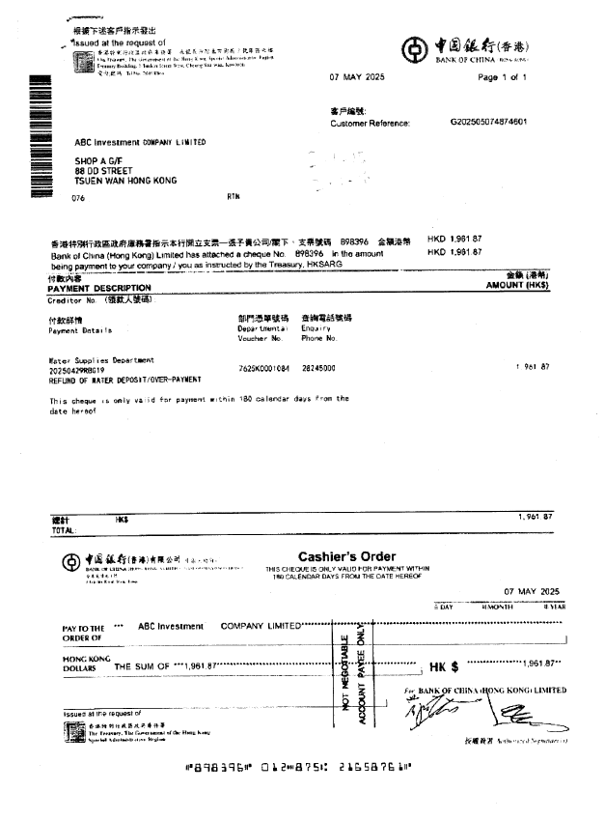
Cashier Order from Bank
Refund Credit Note
Sometimes no Credit Notes from Vendor

Slide 14
Agentic AI Expectations
Use Case 4 On-Hold :
Derive GL Account Code according to the line item’s description.
Rationale:
Bill To Company may not be the actual utilization business unit.
We have multiple GL Account Code referring to the same expense according to the utilization business unit.
Further involvement on Cost Center mapping
Sounds like AI could help when OCR could further read hand-written notes to bridge the gap.
Expectation: AWS feedback on whether AI could read human written notes.

Slide 15
Expected Outcome & Timeline for POC
Format: CSV file or Result in Table format.
Columns: Per previously slides.
Usage: Facilitate users to copy and paste output to Journal Entries Excel Template.
Tentative Timeline: Early July-2025.

Slide 16
POC Success Criteria
Accuracy of Data Extraction:
Target: Define 95% accuracy rates for reading key invoice fields (e.g., Vendor Name, Invoice Total Amount).
Measurement: Percentage of correctly extracted data compared to the verified ground truth from the invoices.
Performance and Speed:
Target: 5 mins to process invoices from reading to mapping. +10 mins to process if any human interaction could be implanted to the workflow.
Measurement: Average processing time per invoice and overall throughput.
Robustness Against Variability:
Target: Success in handling different formats of PDFs (original vs. photocopied). 10% accuracy rates variation.
Measurement: Accurate reading rate across the various invoice formats tested.

Slide 17
POC Success Criteria
Integration with Existing Journal Entries Template:
Target: Facilitate to use output of this application to our daily use template. 95% accuracy rates for mapping Vendor Code and Payment Terms
Measurement: Percentage of correctly mapped data compared to the verified ground truth from the invoices.
Error Rate:
Target: Keep the error rate below a 15% threshold.
Measurement: Count of misread items among total items processed.
Complete Vendor Identification:
Target: Ensure the AI successfully identifies vendors from the invoice against your pre-existing list, including handling missing information.
Measurement: Number of successful identifications and correct matches.
Effective Payment Term Code Assignment:
Target: AI should correctly associate invoices with the right payment terms.
Measurement: Verification of correct payment term code extracted for each invoice.

Slide 18
POC Success Criteria (Optional)
Scalability:
Target: The ability to handle increased volumes of invoices or more complex invoices as business needs grow. Allow multiple users to work on the application without interference from invoices of other users.
Measurement: Performance metrics as the load increases, ensuring it maintains required accuracy and speed.
User Feedback and Satisfaction:
Target: Obtain feedback from GIT stakeholders on the AI's usability and effectiveness.
Measurement: Surveys or interviews with GIT stakeholders to evaluate satisfaction levels and perceived value.
Flexibility and Adaptability:
Target: Ability of the AI to adapt to new invoice layouts or changes in vendor information.
Measurement: Time and resources needed for AI retraining or adjustments post-implementation.

Slide 19
Future Exploration
There are far more fields to do mapping and use logic to derive value.
Highlight the fields which may need further feasibility study.
How an interactive model can be achieved with human decision?
How to pass single value/data tables to AI for further processing?

Slide 20
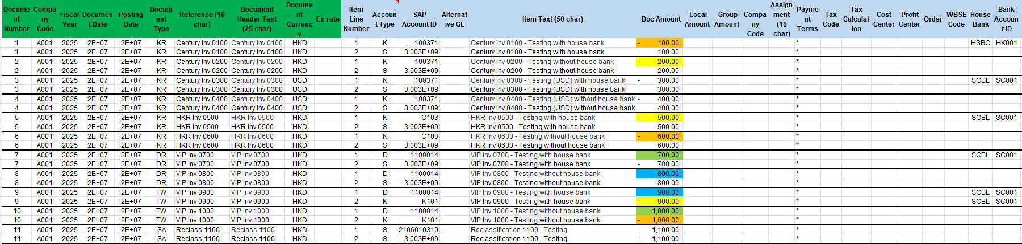
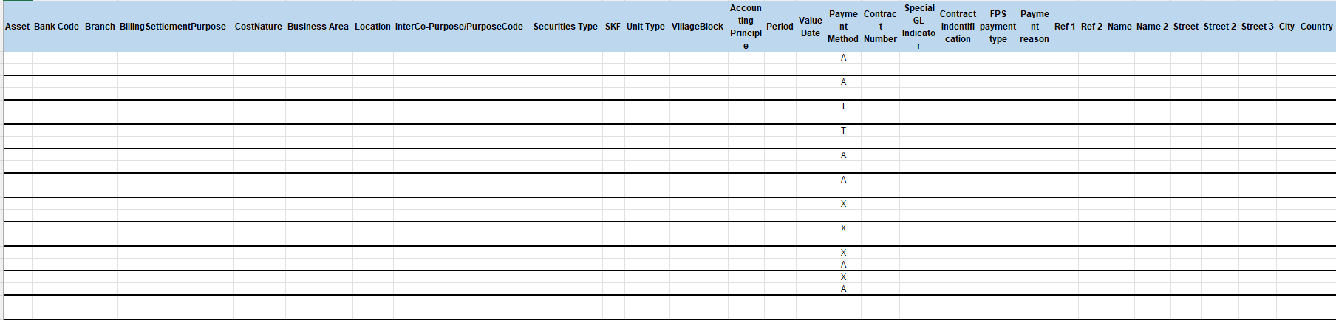
Appendix: Journal Entries Import Template
Field Mapping
Company Code Driven By Hand Written Utilization Business Unit.
Cost Center and Profit Center mapping according to the Utilization Business Unit (1 to multiple further mapping criteria).
Fiscal Year Value Driven By System Date
Document Type Derived By Nature of the Invoice/Bill (e.g. Intercompany Invoice, Regular Invoice, Credit Memo)
WBSE Code Driven By Hand Written or by Vendor Mapping.
Business Area mapping according to the Utilization Business Unit.
Special GL Indicator /Alternative GL Derived By Nature of the Expense (e.g. Refundable Deposit).
Direct Field Recognition for One Time Vendor (Name, Street…)
Visual: Sample Journal Entries Import Template to be displayed.

Slide 21
-End-

